Slide 1
ERD to Hibernate

Slide 2
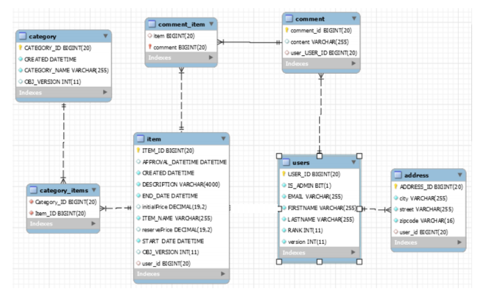
First let’s identify the associations between the tables from the diagram

